Slide 1
JSON-LD
Minimal generic standard RDF format for definition and exchange of ontologies/taxonomies/glossaries
Michal Miklas 2020-02-20

Slide 2
JSON-LD
https://www.w3.org/TR/json-ld11/ JSON-LD is designed to be usable directly as JSON, with no knowledge of RDF [RDF11-CONCEPTS]. It is also designed to be usable as RDF in conjunction with other Linked Data technologies like SPARQL [SPARQL11-OVERVIEW]. Developers who require any of the facilities listed above or need to serialize an RDF graph or Dataset in a JSON-based syntax will find JSON-LD of interest. People intending to use JSON-LD with RDF tools will find it can be used as another RDF syntax, as with [Turtle] and [TriG]. Complete details of how JSON-LD relates to RDF are in section § 10. Relationship to RDF: https://www.w3.org/TR/json-ld11/#relationship-to-rdf

Slide 3
Glossaries explored
Schema.org – simple enough, based on rdf/rdfs, (class, property, subclass), but has custom domain and range constructs. Mostly missing: category/container type for grouping of terms. Schema metamodel types (e.g. class & property) are however not used as types in the json-ld, instead it relies on rfd: / rdfs: )
https://schema.org/version/6.0/all-layers.jsonld
CIM – custom constructs in the json-ld (aliases within context section) that are not part of rdf/rdfs or other w3 standard, e.g.: subjectArea, entityGroups, classConcepts, propertyConcepts, schemas. Also additional custom aliases: name -> rdfs:label, description -> rdfs:comment
https://cloudinformationmodel.org/dist/model.jsonld
Gs1 (extending schema.org) – appropriate format, but maybe too many namespaces from which some of them are only used very little within the definitions, still some of them useful e.g. “dc:”
https://www.gs1.org/docs/gs1-smartsearch/gs1Voc_v1_2.jsonld

Slide 4
Json-ld
Two main sections:
Context
Graph
Good example:
https://www.gs1.org/docs/gs1-smartsearch/gs1Voc_v1_2.jsonld

Slide 5
Json-ld rdf triple store context
Context defines the namespaces and the aliases of the types used in the triple store definitions of object (graph)
"@context": {
"owl": "http://www.w3.org/2002/07/owl#", <- optional
"rdf": "http://www.w3.org/1999/02/22-rdf-syntax-ns#", <- core
"rdfs": "http://www.w3.org/2000/01/rdf-schema#", <- core
"sh": "http://www.w3.org/ns/shacl#", <- optional
"skos": "http://www.w3.org/2004/02/skos/core#", <- optional
"xsd": "http://www.w3.org/2001/XMLSchema#" <- core
}

Slide 6
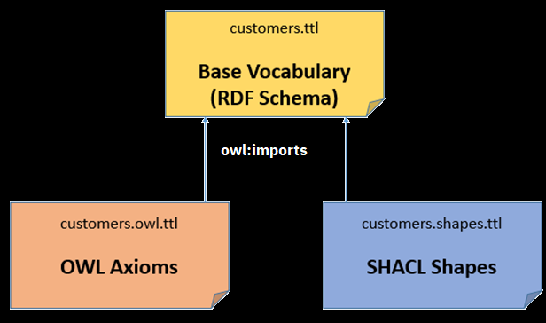
SHACL and OWL Compared
https://spinrdf.org/shacl-and-owl.html
The article explains how the OWL and SHACL can coexist for backward compatibility that would use OWL only
Assuming here three files:
pure RDF/RDFS
OWL extensions (optional)
SHACL extensions (optional)
Assuming it would work for JSON-LD the same way as described fro TTL in the article

Slide 7
Json-ld rdf triple store - graph
Graph is just an array of the json objects
"@graph": [
{"@id": "Product", "@type": ["rdfs:Class“]},
{"@id": “Color", "@type": ["rdf:Property"]},
{"@id": “Customer Managment", "@type": ["rdfs:Container"]}
]

Slide 8
Minimum of rdf/rdfs types used
rdfs:class – for concepts, terms, entities, types
rdf:property – for descriptive characteristics of above
rdfs:container – for groups of classes and properties (not exhaustive unorder collections)
rdfs:member – for allocation of classes and properties to containers
rdfs:comment – object description
rdfs:label – object name
rdfs:subClassOf – supertype of class – a reference to another class
rdfs:domain – property owning class
rdfs:range – property (data or object) type – reference to a class if object
xsd:* primitive data types

Slide 9
Optional OWL/SHACL constructs
owl:Class (in addition to rdfs:Class)
owl:ObjectProperty (in addition to rdf:Property)
owl:DataProperty (in addition to rdf:Property)
owl:FunctionalProperty (in addition to owl:ObjectProperty, owl:DataProperty, rdf:Property ) – defines the property as unique identifier
owl:Ontology – for definition of the whole glossary/vocabulary/model
sh:shape (in addition to rdfs:Class)
sh:property (in addition to rdf:Property)
owl:minCardinality or sh:minCount
owl:maxCardinality or sh:maxCount
sh:path – defines property name - seems like equivalent to rdfs:label on rdf:Property

Slide 10
Optional potentially useful types
rdfs:seeAlso (if links to external glossaries – or other open standards are provided)
owl:sameAs
skos:exactMatch (if links to external glossaries – or other open standards are included in the definition of glossary/ontology)
skos:altLabel - for alternative names
Other for consideration:
skos:collection vs rdfs:container https://www.w3.org/wiki/SkosDev/SkosCore/CollectionsAndArrays
sh:datatype – not sure about advantage of this over range on property with xsd data type
skos:example

Slide 11
Exclusions and other considerations
For sake of simplicity would not consider these constructs:
Property subtyping
Inverse of ( for example as defined for object property in schema.org)
Superseded by
Required custom attribute - need to find whether appropriate constructs exist in existing namespaces
Alternate names (only see something like this in schema.org but no in a w3 standard)
Identifier (only see something like this in schema.org but no in a w3 standard)
Labels – can we use categories?
How to model custom relationships e.g. between properties, for example “calculated from” or “derived from”?
Should it be possible to use the schema.org the same way as rdf/rdfs/owl? Or just for extending its content – what I mean that schema.org is not used as metamodel, hence the schema:* is never used for @type in gs1 for example.

Slide 12
Container
{
"@id": “im-banking:Product Analysis",
"@type": "rdfs:Container" ,
"rdfs:comment": {
"@language": "en",
"@value": “Grouping of concepts – both classes and properties – used for analysis of the product."
},
"rdfs:label": {
"@language": "en",
"@value": “Product Analysis“
},
"rdfs:member {"@id": "im-banking:Customer Management“}
}

Slide 13
Class
{
"@id": “im-banking:Financial Product",
"@type": "rdfs:Class",
"rdfs:comment": {
"@language": "en",
"@value": " Goods and services that can be offered, sold or purchased by the financial Institution."
},
"rdfs:label": {
"@language": "en",
"@value": “Product"
},
"rdfs:subClassOf": { "@id": "im-banking:Product“ },
"rdfs:member": [ {"@id": "im-banking:Product Analysis"},
{"@id": "im-banking:Customer Management"} ]
}

Slide 14
Property – data property (range = primitive data type)
{
"@id": “im-banking:Unit Price",
"@type": "rdfs:Property",
"rdfs:comment": {
"@language": "en",
"@value": "Unit price as set by the organization for goods and services sold."
},
"rdfs:label": {
"@language": "en",
"@value": “Unit Price"
},
"rdfs:domain": { "@id": "im-banking:Product" },
"rdfs:range": { "@id": "xsd:float"},
"rdfs:member": [ {"@id": "im-banking:Product Analysis"},
{"@id": "im-banking:Customer Management"} ]
},

Slide 15
Property – object property (range = class)
{
"@id": “im-banking:Product Owner",
"@type": [ "rdfs:Property " ],
"rdfs:comment": {
"@language": "en",
"@value": “Company who developed and sells the product."
},
"rdfs:label": {
"@language": "en",
"@value": “Product Owner"
},
"rdfs:domain": { "@id": "im-banking:Product"},
"rdfs:range": { "@id": "im-banking:Organization"},
"rdfs:member": {"@id": "im-banking:Product Analysis"}
},

Slide 16
Industry Models Glossaries
Each Industry glossary could be defined within its own namespace
Would probably settle on one json-ld per industry/namespace
For example:
im-banking:
im-insurance:
im-healthcare:
im-energy:
Each namespace represents a separate glossary/vocabulary

Slide 17
GS1 glossary definition - useful section but rellies on too many namespaces just for definition of the glossary object - might be necessary to include it all in similar fassion
{
"@id": "gs1:",
"@type": [
"voaf:Vocabulary",
"owl:Ontology"
],
"schema:license": "data:text/html;charset=UTF-8,<p>GS1&reg;, under its IP Policy, seeks to avoid uncertainty regarding intellectual property claims by requiring the participants in the Work Groups that developed this vocabulary to agree to grant to GS1 members a royalty-free licence or a RAND licence to Necessary Claims, as that term is defined in the GS1 IP Policy. Furthermore, attention is drawn to the possibility that an implementation of one or more features of this vocabulary may be the subject of a patent or other intellectual property right that does not involve a Necessary Claim. Any such patent or other intellectual property right is not subject to the licencing obligations of GS1. Moreover, the agreement to grant licences provided under the GS1 IP Policy does not include IP rights and any claims of third parties who were not participants in the Work Groups. Accordingly, GS1 recommends that any organisation developing an implementation designed to be in conformance with this vocabulary should determine whether there are any patents that may encompass a specific implementation that the organisation is developing in compliance with the vocabulary and whether a licence under a patent or other intellectual property right is needed. Such a determination of a need for licencing should be made in view of the details of the specific system designed by the organisation in consultation with their own patent counsel. THIS DOCUMENT IS PROVIDED &quot;AS IS&quot; WITH NO WARRANTIES WHATSOEVER, INCLUDING ANY WARRANTY OF MERCHANTABILITY, NONINFRINGMENT, FITNESS FOR PARTICULAR PURPOSE, OR ANY WARRANTY OTHER WISE ARISING OUT OF THIS SPECIFICATION. GS1 disclaims all liability for any damages arising from use or misuse of this vocabulary, whether special, indirect, consequential, or compensatory damages, and including liability for infringement of any intellectual property rights, relating to use of information in or reliance upon this document. GS1 retains the right to make changes to this vocabulary at any time, without notice. GS1 makes no warranty for the use of this vocabulary and assumes no responsibility for any errors which may appear in the vocabulary, nor does it make a commitment to update the information contained herein. GS1 and the GS1 logo are registered trademarks of GS1 AISBL.</p><p>Copyright 2015-2019 GS1 AISBL</p><p>Licensed under the Apache License, Version 2.0 (the &quot;License&quot;); you may not use this file except in compliance with the License. You may obtain a copy of the License at <a href=&quot;http://www.apache.org/licenses/LICENSE-2.0&quot; target=&quot;blank&quot;>http://www.apache.org/licenses/LICENSE-2.0</a>.<p><p>Unless required by applicable law or agreed to in writing, software distributed under the License is distributed on an &quot;AS IS&quot; BASIS, WITHOUT WARRANTIES OR CONDITIONS OF ANY KIND, either express or implied. See the License for the specific language governing permissions and limitations under the License.</p>",
"dc:contributors": "Eric Kauz, Mark Harrison, Phil Archer",
"dc:creator": {
"@id": "https://www.gs1.org/"
},
"dc:description:": {
"@language": "en",
"@value": "The GS1 RDF vocabulary, described using W3C RDF Schema and the Web Ontology Language. The vocabulary builds on and refers to schema.org where appropriate."
},
"dc:identifier:": "GS1 Vocabulary",
"dc11:title": "GS1 Vocabulary",
"dc:issued:": {
"@type": "xsd:date",
"@value": "2017-11-20"
},
"dc:lastModified": {
"@type": "xsd:date",
"@value": "2019-12-01"
},
"owl:versionInfo": "1.2",
"vann:preferredNamespacePrefix": "gs1",
"vann:preferredNamespaceUri": {
"@id": "gs1:"
},
"voaf:extends": {
"@id": "schema:"
},
"voaf:hasEquivalencesWith": {
"@id": "schema:"
},
"voaf:specializes": {
"@id": "schema:"
}
}

Slide 18
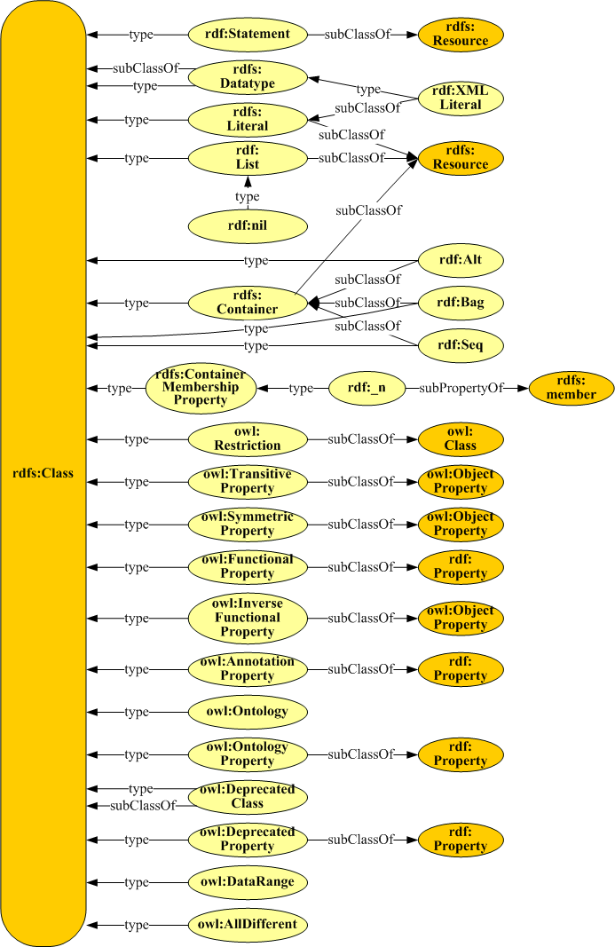
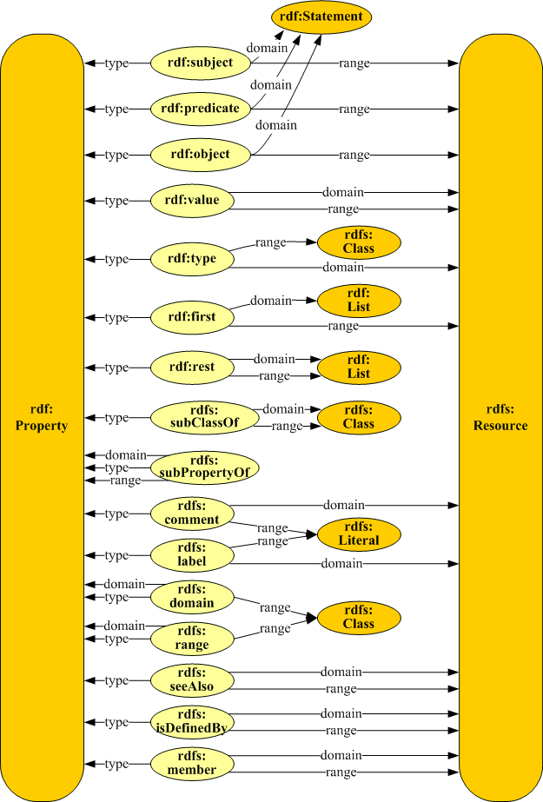
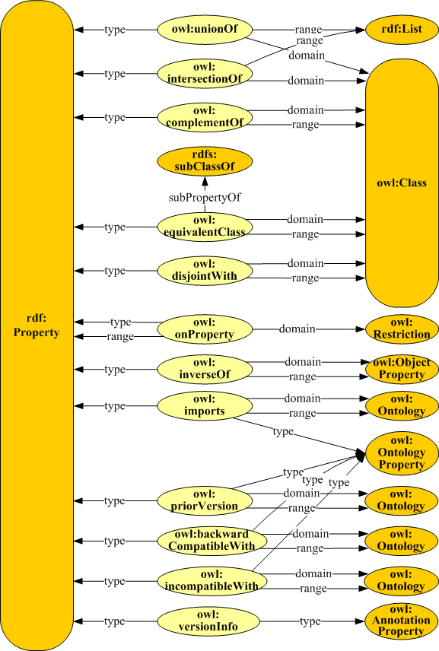
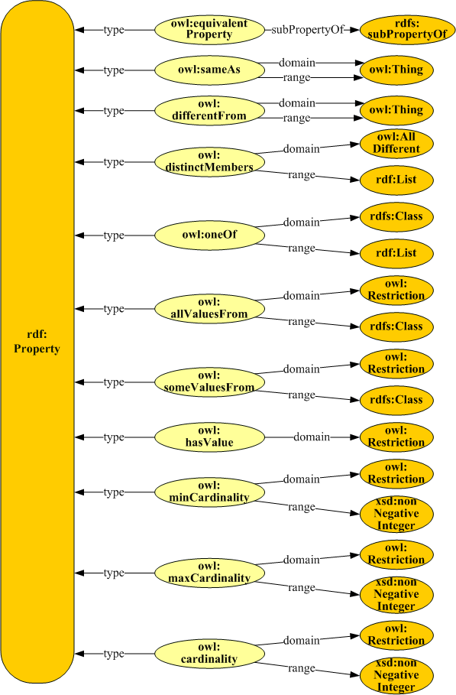
RDF & OWL overview diagrams https://www.infowebml.ws/rdf-owl/graphical-representations.htm

